Slide 1

PARTICIPATINGIN AN FSA
FX-1019-050720
Notes:
Good news! Your employer offers a valuable Flexible Spending Account as part of your employee benefits package.
This video will cover the benefits and features of participating in the FlexSystem FSA Plan.
FlexSystem is the name of the FSA Plan available to you through your employer, and is administered by TASC.

Slide 2


FLEXIBLE SPENDING ACCOUNTS
Healthcare
Dependent Care
Notes:
Flexible Spending Accounts—called FSAs—are a great way to save money on everyday expenses.
In this first section, we will cover the basics of what an FSA is, and then we’ll walk through what you can expect with the FlexSystem FSA Plan.
An FSA pre-tax reimbursement benefit that is free for you since it’s entirely paid for by your employer.
Benefit options may include a Healthcare FSA, Dependent Care FSA, Transit and Parking Account, and Non-Employer Sponsored Health Insurance Premiums. Check with your employer to find out which benefits are offered under your Plan.
You determine which FSA benefits to participate in and the total dollar amount you wish to contribute to each one for the Plan Year. Your contributions will be deducted from your payroll pre-tax and deposited into your designated benefit accounts, to then be used to pay for eligible expenses throughout the Plan Year.
Please note, if you or your spouse are enrolled in a Health Savings Account (or HSA), your eligibility to participate in a Healthcare FSA is limited. Contact TASC or your employer for details.

Slide 3

Tax Advantages
Designed to save you money!
Money in an FSA is never taxed
  No federal income tax
  No state income tax
  No social security tax
Every dollar you contribute is pretax, reducing your taxable income and increasing your take-home pay!
The more you contribute,
the more you save
Notes:
The greatest advantage of participating in an FSA Plan is the tax-savings.
Every dollar you contribute to the FSA Plan is deducted from your payroll – PRE-TAX – which reduces your taxable income and thereby increases your take-home pay!
By participating, you reduce your income taxes by an average of 30 percent every year.
[CLICK] With pre-tax deductions, the more you contribute, the more you save.
Let’s look at an example…

Slide 4
FSA Savings Example
Sam’s Annual Salary: $35,000
Out-of-Pocket Medical Expenses: $ 1,000/year
Out-of-Pocket Dependent Care Expenses: $ 1,500/year
1
2
No FSA With FSA
Gross Pay $ 35,000 $ 35,000
FSA Contribution (health & dep care) - $ 0 - $ 2,500
Taxable Income $ 35,000 $ 32,500
Taxes (Fed, State, FICA) @ 25% - $ 8,750 - $ 8,125
Out-of-Pocket Expenses - $ 2,500 - $ 2,500
Reimbursement from FSA + $ 0 +$ 2,500
Take-Home Pay $ 23,750 $ 24,375
Sam saves $625 per year!
Notes:
In this savings example, Sam earns $35,000 a year and he estimates that he will spend a total of $2500 this year on medical and daycare expenses combined.
So he decides to make a total annual election of $2500 to the FSA Plan, because he would prefer to get a tax-break on that money.
Let’s calculate his savings:
[CLICK1] In this side-by-side comparison, we deduct the $2500 FSA contribution from Sam’s gross income in column 2 – remember, it comes out pre-tax.
[CLICK2] This gives Sam a new taxable income under FSA.
[CLICK3] Next, we deduct the post-tax expenses, likes income taxes, from both columns. Notice in column 2 under FSA, Sam pays LESS taxes.
[CLICK4] We will also deduct the $2500 that Sam needs for his eligible out-of-pocket expenses from both columns.
[CLICK5] However, in column 2 with FSA, Sam can reimburse himself for the $2500 with funds he contributed to the FSA.
[CLICK6] This bring us to the total annual Take-Home Pay amount for each scenario – and as you can see in column 2 under the FSA, Sam’s annual take-home pay is $625 more than if he didn’t use the FSA Plan. That’s a big savings!
Use this example to calculate your own potential savings per year, or use our online calculator on our website at tasconline.com.

Slide 5

Healthcare FSA
With rising healthcare costs, every penny counts!
Annual Election: Set aside pretax dollars to be used toward eligible healthcare expenses throughout the Plan Year
  Annual election must be within IRS maximum contribution limit
  Applies to Employee (self), Spouse, and/or Dependents
  Maximum Dependent Age: 26
100% of annual election available on day one.
Use-it-or-Lose-it Rule applies
Notes:
With rising healthcare costs, every penny counts. And a Healthcare FSA can save you money.
So, how does it work?
You determine how much money to contribute to the FlexSystem Healthcare FSA based on estimated out-of-pocket medical expenses for you and your dependents during the plan year (within the IRS maximum). This is called your “Annual Election.”
Your annual election is deducted from your payroll – PRE-TAX – in equal increments throughout the Plan Year and deposited into your Healthcare FSA.
What’s great about Healthcare FSA is the immediate availability of your funds! That’s right, 100% of your annual election is available to you on day-one of the Plan Year without having to wait for each deposit from payroll.
You can start using those funds right away to pay for eligible medical expenses.
With any FSA, you must be cautious of the Use-it-or-Lose-it rule which states that any un-used FSA funds at the end of the plan year will be forfeited, so you will want to be conservative with your annual election. Don’t contribute more than you think you will need for medical expenses.
Carryover is an optional feature for Healthcare FSA but only if elected by your employer. It allows you to carry up to $500 of unused Healthcare FSA funds from year to year at no cost or penalty, which means there is no risk to contribute at least $500. Ask your employer if Carryover is available for your plan.

Slide 6
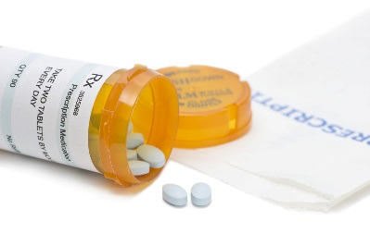


HEALTHCARE FSA: ELIGIBLE EXPENSES
Eligible Expenses:
Co-pays and deductibles
Medical office visits
Prescription drugs
OTC drugs & medications
Feminine care products
Dental/orthodontia care
Vision care
Vaccinations
Smoking cessation programs
Ineligible Expenses:
Insurance premiums
Cosmetic procedures
Vitamins/supplements
Diet products/food
Health club fees
See complete listing of eligible items at www.tasconline.com/eligible-expenses/
Notes:
Use your Healthcare FSA funds to pay for eligible healthcare expenses such as co-pays and deductibles, medical office visits, prescription drugs, dental and orthodontia care, vision care, and vaccinations.
Over-the-counter drugs and medications are eligible only when you have a prescription.
Also, please note that Healthcare FSA funds cannot be used to pay for Insurance Premiums.
Understanding which expenses are eligible for reimbursement is an important part of determining your annual election for the Healthcare FSA.
It also comes in handy to know what you can spend leftover FSA funds at year-end to avoid forfeiture.
For a more comprehensive list of eligible items, visit our website shown on the screen.

Slide 7

Dependent Care FSA
Elect pretax dollars to pay for eligible
dependent day care services
Use-it-or-Lose-it Rule
Money In, Money Out: Dependent Care
funds are only available as they are
contributed to the plan via payroll.
Dependent Qualifications:
  Individual that regularly spends at least 8 hours a day in your home
  Dependent care for children under age 13
  Dependent who is physically or mentally incapable of self-care
  Your daycare provider must claim your payments as income and pay tax
  Review Dependent Care Qualifications Flyer for complete details:
$5,000 max
contribution per year
https://www.tasconline.com/uploads/KB/Flexsystem/FX-3166-080115%20FX%20Dependent%20Care%20Qualifications.pdf
Notes:
Another type of FSA benefit is the Dependent Care FSA.
Similar to the Healthcare FSA, you make an Annual Election based on estimated expenses throughout the plan year, but for dependent care expenses incurred by you (and/or your spouse) while working or attending school full-time.
Your annual election is deducted from your payroll – PRE-TAX – in equal amounts throughout the Plan Year and deposited into your Dependent Care FSA.
The maximum contribution to the Dependent Care FSA is $5,000 per year.
But be sure to calculate your annual expenses carefully since the Use-it-or-Lose-it rule also applies here, but with no option for Carryover.
Unlike the Health FSA, your annual election to Dependent Care FSA is only available to you as payroll contributions are deposited – also known as “money in, money out.”
Review the FlexSystem Dependent Care Qualifications flyer linked here to understand the requirements of participating in a Dependent Care FSA before you enroll.
We also encourage you to compare the benefits of participating in a Dependent Care FSA versus taking the IRS Child Care Tax Credit – because you can’t do both.
Look for our education flyer that explains how to compare these two tax options.

Slide 8


DEPENDENT CARE FSA: ELIGIBLE EXPENSES
Eligible Expenses:
Daycare expenses
Before and after school care
Nanny expenses
Nursery school
Registration fees
Elder care/Nursing home
Ineligible Expenses:
Tuition
Transportation
Activity fees/supplies
Field trips
Overnight camp
Notes:
Use your Dependent Care FSA funds to pay for eligible expenses like daycare, before and after school care, nursery school, nanny, and even elder care.
It is important to note that you cannot use Healthcare FSA funds to pay for dependent care expenses and vice versa. They are separate benefit accounts.

Slide 9

HOW MUCH SHOULD YOU CONTRIBUTE?
Estimate out-of-pocket expenses for the Plan Year for you and your qualified dependents:
for
Employee (self), Spouse,
and/or Dependents
  Healthcare expenses
for
  Dependent Care expenses
Qualified Dependents
Make sure your expenses qualify for FSA reimbursement
Follow tax guidelines, rules, and limits.
View IRS contribution limits at www.tasconline.com/benefits-limits
Notes:
Once you’ve determined which FSA benefits are available from your employer and which ones you wish to participate in, the next step is to determine how much money you should contribute to each benefit account.
Carefully estimate the annual out-of-pocket expenses for you and your dependents to determine your Annual Election for each benefit account. Be conservative. Only set aside dollars you will actually use during the Plan Year.
Also, check the list of Eligible Expenses for each benefit to make sure your estimated expenses will qualify for reimbursement.
And of course, make sure your annual elections follow the tax guidelines and limits for each benefit.

Slide 10
Use-it-or-lose-it rule
Leftover FSA funds are forfeited at year-end
Notes:
When considering how much to contribute, it is also important to understand the Use-it-or-Lose-it Rule, which states that any un-used FSA funds at the end of the plan year will be forfeited.
To help protect your funds, employers may choose to implement a Carryover option or a Transitional Period with your plan.
If Carryover is available, you may carry up to $500 of your leftover Healthcare FSA funds into the next Plan Year with no penalty or forfeiture. This means there is absolutely no risk to contribute at least $500 per year to your Healthcare FSA.
Carryover funds are automatically moved into the new Plan Year after the Plan Runout End Date, even if you made no election for the new Plan Year – or you may manually move them sooner via your MyTASC account. Any remaining funds in excess of $500 will be forfeited. Please note, carryover only applies to Healthcare FSA.
If a Transitional Period is available, you have an extended period of time beyond year-end to use your remaining funds.
Check with your employer to find out what is available under your plan so you can plan your annual elections accordingly. And as the end of the plan year nears, check your balances frequently for remaining funds and determine how you can use them before it’s too late.

Slide 11
FLEXSYSTEM PLAN FEATURES
Notes:
Now that you understand the benefits of an FSA, let’s go over how the FlexSystem Plan works.
As a FlexSystem participant, you have access to many great tools and features to easily manage your FSA benefits and access your funds.

Slide 12

HOW TO PARTICIPATE
Enroll in FlexSystem each year to participate
(does not automatically renew)
Elect your annual election for each account type
Pretax payroll deductions begin
on Plan Year start date
Access your FlexSystem funds
to pay for eligible expenses
Notes:
To participate in FlexSystem, you must enroll each year, as your enrollment does not automatically renew year after year.
Enrollment is available online or with a paper form, as instructed by your employer.
With online enrollment, you can quickly and easily setup your FSA benefits from your home computer using our secure MyTASC web portal.
Simply select the FSA benefits to participate in and your annual election for each -- not to exceed the IRS allowed maximums.
Your annual election for each enrolled benefit will begin to deduct from your payroll on a pre-tax basis on your Plan Year start date and continue throughout the year in equal amounts.
Once your payroll contributions deposit into your FlexSystem accounts, you may begin to use those funds to pay for eligible expenses.

Slide 13
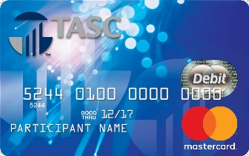

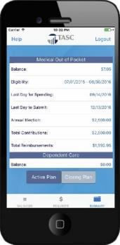
Two Ways to Access FSA Funds
TASC Card
(Benefits Debit Card)
Request for Reimbursement
Notes:
FlexSystem offers two ways to access your FSA funds:
The most convenient method is the TASC Card -- a benefits debit card that provides easy access to your FlexSystem funds. Simply swipe your TASC Card where Mastercard is accepted to pay for eligible expenses directly from your FlexSystem account.
New participants will receive a TASC Card in the mail within 2 weeks of enrollment.
If you are a returning Participant, hang on to your current TASC Card… it will be reloaded at the beginning of each Plan Year.
If you don’t use the card for an eligible purchase, you can submit a Request for Reimbursement using one of many methods, including our free mobile app.
The next few screens offer more details on how these two options work.

Slide 14

TASC Card Features
Replaces out-of-pocket purchases
& reimbursements for:
  eligible healthcare expenses
  eligible dependent care expenses
No RFR forms to complete or receipts to submit
Good for 4 years – automatically reissued
One additional card for dependent or spouse at no charge
Notes:
The TASC Card gives you instant access to the available funds in your FlexSystem account to pay for eligible FSA expenses at the point-of-purchase.
This saves you the time and hassle of paying out-of-pocket and submitting a request for reimbursement.
The healthcare inventory system automatically approves the purchase of most eligible items and deducts the amount from your benefits account, with no additional substantiation required. Although, we do encourage you to keep your receipts in the event that substantiation is requested.
Each TASC Card is good for 4 years and is automatically reissued when it expires.
You may request one additional TASC Card at no cost – however, any additional cards are $10 each.

Slide 15
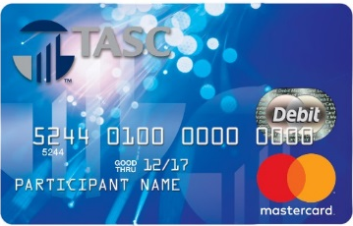
TASC Card Accounts
MyBenefits Account
  Qualifies and pays eligible FSA expenses on the spot
MyCash Account
  Reimbursements are fast and convenient (within 12 hrs)
  MyCash funds are used just like cash at any retailer that accepts Mastercard for any purchase
  Can also withdraw cash via ATM or transfer to bank account
It’s a “Smart Card”
Eligible FSA expenses are paid from the MyBenefits account
Non-benefit purchases are paid from the MyCash account
Notes:
Our industry-exclusive TASC Card features two accounts on one card: the MyBenefits account for qualified FSA purchases, and the MyCash account for reimbursements and spending.
[CLICK] With smart-card technology, the TASC Card is able to pull funds from the appropriate account based on the type of purchase.
When you submit a Request for Reimbursement for an eligible purchase, that reimbursement payment is directly deposited into your MyCash account within 12-hours -- that’s faster than a bank deposit!
And you can access your MyCash funds with the swipe of your TASC Card anywhere Mastercard is accepted, for any purchase -- or withdraw cash from an ATM.
With MyCash, your TASC Card serves as both a benefits debit card and a cash card.

Slide 16

MyCash FUNDS
Funded by reimbursement deposits
Access MyCash funds:
  TASC Card (Mastercard accepted)
  ATM cash withdrawal
  Transfer to a personal bank account
One transaction for FSA and retail purchases
No expiration
MyCash Manager online
  View transactions, schedule a transfer
Notes:
Your MyCash account starts with zero dollars and grows when you submit a Request for Reimbursement for an eligible item.
Once your reimbursement is deposited into MyCash, you can access those funds with by using your TASC Card for a purchase, withdrawing cash from an ATM, or transferring it to a personal bank account. Or you may rely on MyCash to cover any FSA purchases that exceed your FlexSystem balance and avoid embarrassing declines.
It’s also helpful to have funds in both accounts so you can purchase FSA and retail items together in one transaction. The TASC Card is smart enough to know that eligible FSA items are paid from MyBenefits and general retail items are paid using MyCash.
Unlike FSA funds, your MyCash funds do not expire. The MyCash account holds your reimbursement funds until you spend or move them.
Log in to MyTASC online to manage your MyCash account, view transactions, and even transfer your money to another account.

Slide 17
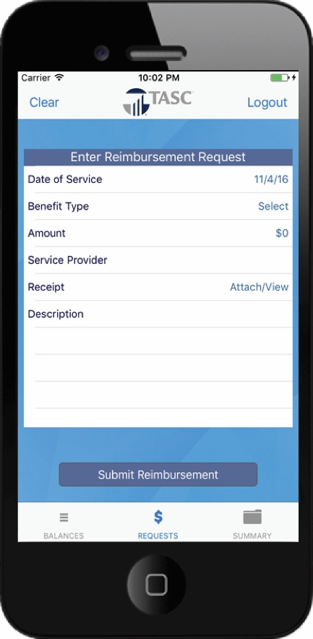
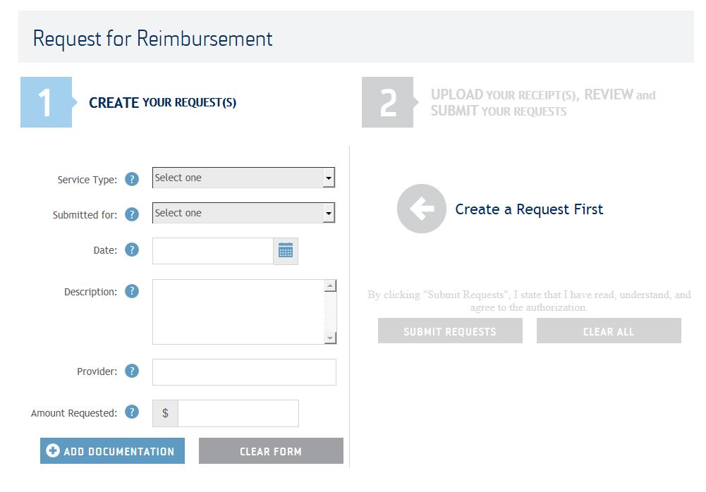
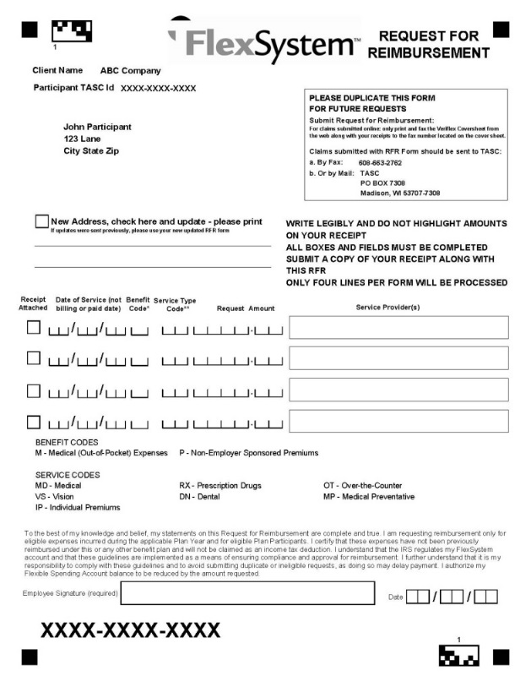
Requesting a Reimbursement
ONLINE REQUEST
MOBILE APP
PAPER REQUEST FORM
Notes:
17
While the TASC Card is the most convenient way to pay for an eligible expense, if you are unable to use your TASC Card, you can pay for the expense out-of-pocket and submit a Request for Reimbursement to FlexSystem using the MyTASC web portal, our mobile app, or by submitting a paper request form.
Reimbursement payments are directly deposited into your MyCash account on your TASC Card, or you may choose to receive reimbursements via direct deposit to a designated bank account. You can set that up on your Profile in your MyTASC online account.

Slide 18
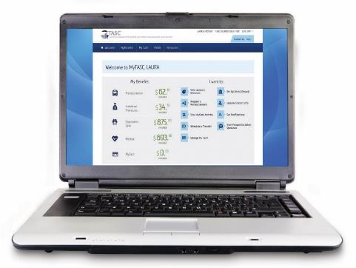
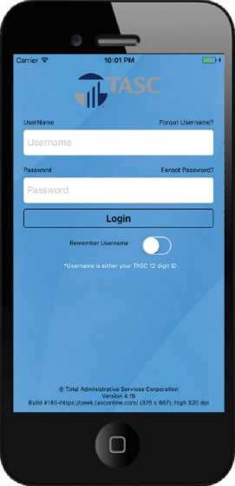

Account management
MyTASC Web Portal
  Request a reimbursement
  Set auto notifications
  View account overview
  Manage your TASC Card
MyTASC Mobile App
  View account balances/ transactions
  Submit requests for reimbursement
  Easily upload pictures of receipts
  Text Messaging – request a balance
Notes:
The FlexSystem Plan is easy to access and manage with our secure user tools.
The MyTASC web portal is your secure online account management website.
Whether you want to view your account balances, request a reimbursements, update your preferences, or manage your TASC Card – all of this and more can be accomplished when you log in to your MyTASC account.
You can also access your account on the go with the MyTASC Mobile App that allows you to view real-time account balances and submit requests for reimbursement using your phone camera to easily upload pictures of receipts. Download it for free on any Apple or Android device.
You can even send us a text message to request a current account balance on your mobile phone.

Slide 19


Customer care
www.tasconline.com
1.800.422.4661
MyTASC Online
Log in to MyTASC
Click “Contact Us”
Fill out service request
24-48-hour response time
Interactive Voice Response
Have 12-digit Participant ID number ready
Available 24/7
Live Telephone Support
Monday-Friday
8:00am – 5:00pm (all time zones)
Notes:
If you need assistance with your FlexSystem Plan, please contact Customer Care by submitting an online service request or call toll-free at 1-800-422-4661.
Our friendly and knowledgeable Customer Care specialists are always happy to help.

Slide 20
THANK YOU
Notes:
Thank you for viewing this education video.
We encourage you to review all of our education materials to fully understand the valuable benefits of an FSA.

